Slide 1


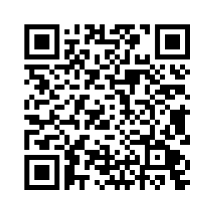



Code of conduct for a responsible stay
✅ DO’S
❄️ Use air conditioning moderately and turn it off when leaving
🪟 Close windows when air conditioning or heating is on
🌞 Keep shutters, blinds, and curtains open during the day for the plants
⚡ Turn off lights, air conditioning, and unused appliances
🚪 Close appliance doors after use
🚿 Turn off water taps after use
🔐 Close all windows and double-lock the front door when leaving
🟢 Use only cupboards with a green sticker or no sticker
♻️ Sort waste properly into the correct bins (glass, plastic, general waste)
🔄 Air out the apartment regularly to avoid humidity
🧹 Keep the apartment always clean
🏡 Treat the apartment as if it were your own
📸 Report any broken or damaged items
📜 Follow the house rules and the check-out procedure
⛔ DON’TS
🎉 Do not host parties or events
🚭 Do not smoke or vape indoors
🔇 Do not make noise between 10:00 p.m. and 8:00 a.m.
🪴 Do not move the plants
🔴 Do not access private areas marked with a red sticker
🚽 Do not flush anything other than toilet paper
👥 Do not invite more than two guests; no overnight stays allowed
🐾 Do not bring animals, even small ones
🛋️ Do not move large furniture (sofa, table, etc.)
🔥 Do not light any flames (candles, incense, etc.)
📵 Do not take photos, videos, or make recordings for public or commercial use
🛴 Do not charge scooters, bikes, or other high-powered electric devices indoors
🧯 Do not block emergency exits or access to the electrical panel
🚫 Do not engage in any illegal activity
By staying in the apartment, you agree to follow this code of conduct.
Emergency numbers
General information
15
Ambulance
Wi-Fi
Network
Freebox-60C5B4
17
Police
Password
c2rckq27ztq62xnwqtchmw
18
Firefighters
112
European emergency number
Hosts
Marco FILIPPI : + 33 6 10 94 38 50
114
Deaf and hard-of-hearing
Tourist Office
www.menton.fr

